Slide 1
IT Infrastructure:
Are We Building Chaos or Cosmos?
Peter S. Kastner
Chief Research Officer
Aberdeen Group, Inc.
One Boston Place
Boston, MA 02108
(617) 723-7890
www.aberdeen.com
Notes:
We all know chaos is …
Cosmos is order and harmony in the universe. That is what all sensible managers want.
As stated here today, without a well-defined and coordinated common infrastructure, we in IT are doomed to the business sins of over budget, poor quality, unreliability, lack of scalability and repeatability.
The 50,000-foot view is that Is spends too much time and money on technology integration -- taking enormous business risks in doing so. A common computing infrastructure would dramatically reduce costs, improve quality, speed project delivery, and lower time-to-market risks.

Slide 2
Agenda
Change versus continuity: who cares?
Fragmented IT infrastructure Issues
Choosing an IT Infrastructure
Options, Implications, and Conclusions
Notes:
Business imperatives are shaking up iT
Technology and business pressures are creating a dangerously fragmented IT infrastructure
Examine six options for handling the infrastructure crisis
Aberdeen’s conclusions

Slide 3
IT Spending: New Acquisition versus
Ongoing Operations
U.S. enterprises spend ~3% of revenue or value-added on IS
~ 85% of IS spending is for on-going operations — ~15% for new application acquisitions
CEO looks at 15% for new applications as incremental change & business driver
CFO and VP IS/CIO look at 85% for on-going operations as area to be closely managed and controlled
Notes:
There is a huge dichotomy between the ongoing costs of IT operations on existing systems and the often-compelling needs to quickly deploy mission-critical systems to gain or defend against competitive advantage.

Slide 4
IT-Driven Business Imperatives
Increase customer satisfaction
Empower fewer users
Increase line access to data
Increase operational flexibility
Shorten application development cycle time
Notes:
Customer satisfaction
Fewer customer-supplier relationships
Customer delight is critical
Trusted-supplier partnerships
Operate on a Virtual Company basis
More revenues from existing customers
Data mining
Leverage existing relationships with new, often opportunistic products and services
New customer capture tactics
Target high probability prospects
Add information value to differentiate product and
Empower Fewer users
Make data accessible to both line managers and staff
Fewer managers and staff will be directly responsible for more of the financial results of the enterprise
Non-programmatic problems must be solved relying on information that may reside anywhere in the enterprise
Empowered end user model: Review. Analyze, , decide, Report
IT must facilitate — not constrain — the enterprise’s ability to function and transform itself
New strategy, tactics, business policy implementations
Acquisitions, divestitures, mergers — information is key component
Business process reengineering
Financial planning including items such as interest rate changes and derivative risks
Government mandates
Quick moving enterprises must have IS development tools that facilitate change — not delay it
Multi-year, only 20% effective application, custom development efforts are not acceptable
RAD means now for minor modifications — nine months for major applications
Server and client development options
License the core multi-user ISV solution ASAP — modify the fat client when convenient
Tradeoffs: functionality vs. time
vs. resources vs. quality

Slide 5
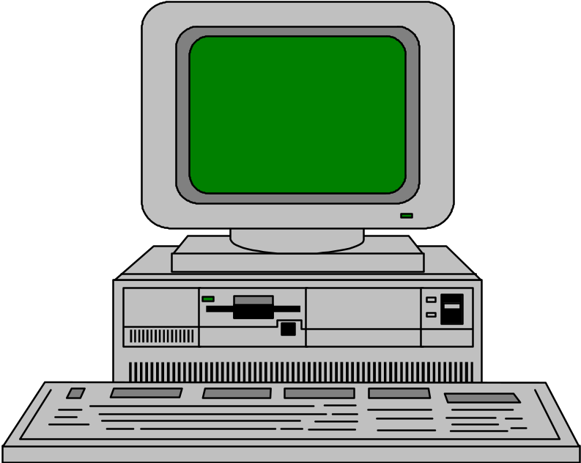
Business Necessity Meets
IS Reality: Insurance Industry
5,000 Users
OLTP Production
System &
Administration
Data Warehouse
Unix or NT cluster
Highly Parallel, Scaleable
Economical, Scaleable
15-500 Users
8,000 users at 50 offices and headquarters
Local transaction processing
against a replicated database
PC desktops and Intel/Risc Office Server
Notes:
A real-world insurance company (and Aberdeen client) is planning a next-generation claims processing system. Any customer can stop in any office for complete support. Claims can be updated from any of 50 local offices.
A server at HQ will manage 3,500 HQ users, systems management, and batch.
Business drivers: cut costs & increase customer satisfaction. Implementation costs are over $175 million.
.

Slide 6
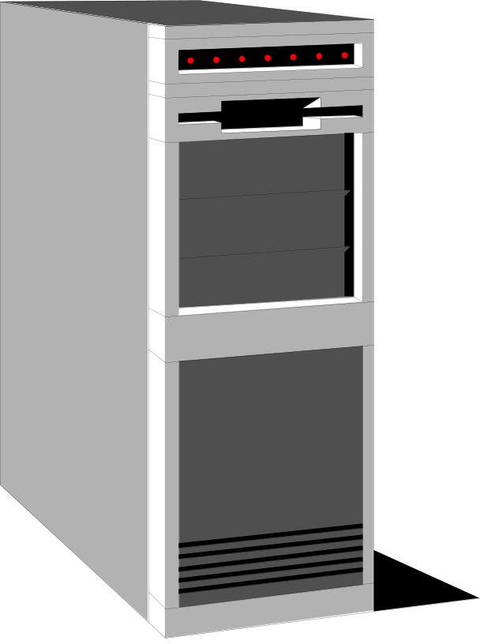
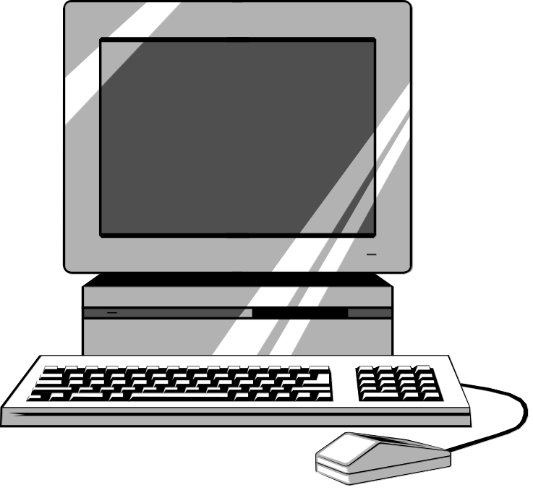
IS Reality:
Enormous Complexity
Data Warehouse Transformation & Replication
Database of
Record
Enterprise
Superserver
Replication to every office
Transaction Push
Transaction Pull
Java & HTML
to Suppliers
Classic 2-Tier Client-Server
Notes:
Local servers in 50 offices are desired for fast, local response time. Each office will have a complete copy of the active claims database. Replication or transaction queuing will be used to pull every transaction from the local office to an “enterprise super-server” at headquarters which will serve as the database of record. This super-server will service 3,500 HQ users, replicate (“push”) all transactions out to all offices, and drive data transformation onto a data warehouse server.
Supporting transactions from 5,000 remote users and 3,500 local users as well as push replication, batch, and data warehouse transformation duties demands considerable computing capacity — beyond traditional SMP architectures and even many clusters.
What computing infrastructure can handle this workload and still be able to grow with the projected 15%-20% annual business volume, be highly available, and flexible enough to support other applications in the future?
This application screams for an overriding common infrastructure which will support the application through its estimated 15 year life.

Slide 7
IT Infrastructure Fragments
Enterprise mainframe
Geographical islands of automation
LANs become Intranets
Data warehousing
Client-server meets the Web
E-business is the tip of an iceberg
The Devil is in the Technology Details
Notes:
-- Transition --
Let’s look at six different ways technology is wacking us on the side of the head.
Failure to pay attention to technology details is the bane of most projects.

Slide 8
What Happened to the Mainframe Data Center?
Thoroughly understood
Predictable reliability
Outstanding operational efficiency, productivity, and manageability
But …
Hasn’t seen a new ISV application in 7 years
Is being surrounded or supplanted
Notes:
The mainframe has been and will be the workhorse for most large enterprises. Unfortunately, the mainframe has not been the platform-of-choice for NEW applications. This has led to a proliferation of platforms, Operating Systems, systems management and other infrastructure costs, personnel and knowledge burdens.

Slide 9
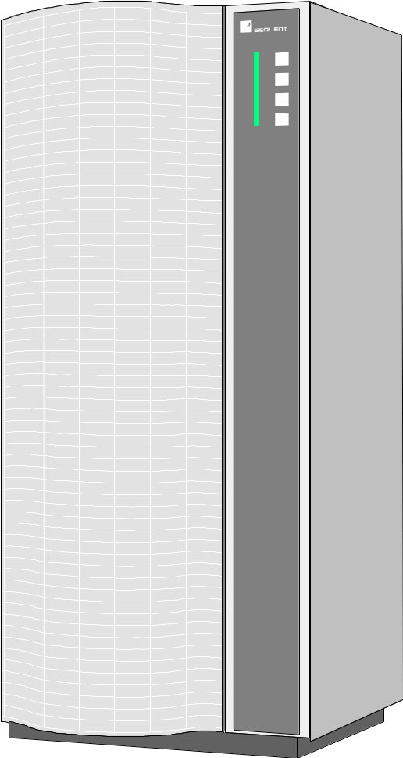

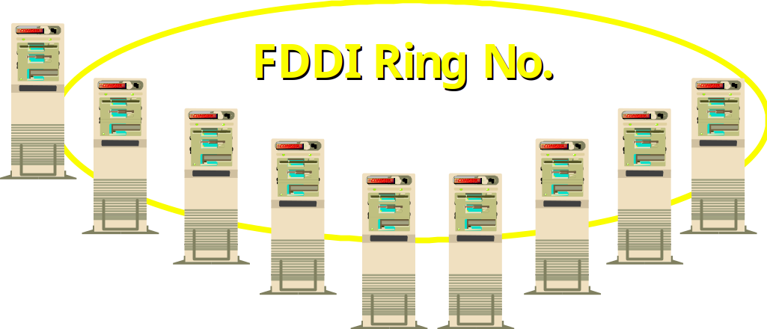
New-Breed Enterprise Mainframe
Enterprise-class
UNIX server
FDDI Ring No. 1
Symmetry SE70
2
Message &
Enqueue Server
10base T
Compaq ProLiant 4000s
Compaq ProLiant 4000s
LANs
Notes:
For some enterprises, the traditional mainframe has given way to
a complicated but less costly N-tier architecture. Any guesses
as to which Fortune 250 company uses this?

Slide 10
New-Breed Enterprise Mainframe
N-Tier architecture
Reliability, operability, manageability constraints
Multi-vendor control issues
But …
Running today’s mission- critical enterprise applications: a paradox
2
Notes:
The infrastructure issues with n-tier platforms are immense:
- Unix and NT
- Gobs of middleware
- systems management and operations
- distributed databases
- distributed applications
- etc.
The concerns about reliability, operability, and manageability are well founded.
Nevertheless, this diagram is the architecture of an SAP R/3 implementation that could be Intel, Cisco or Microsoft.

Slide 11
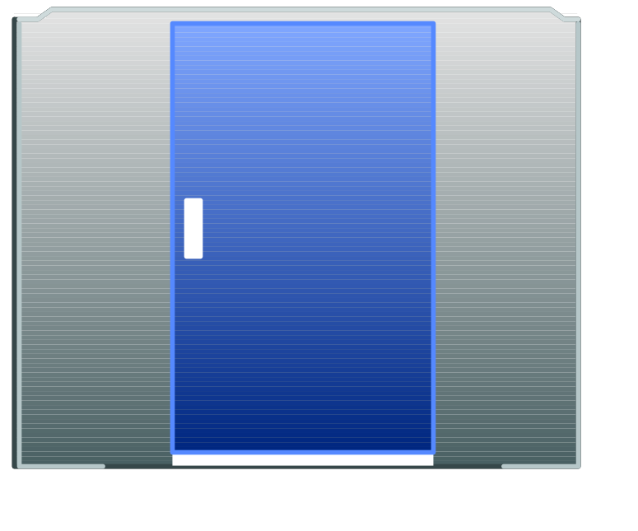
Geographically Distributed Enterprise
Enterprise OLTP
Mainframe Gateways
Management Console
Distributed Enterprise
Interconnected Workgroup
London
Tokyo
San Francisco
100’s to 1000’s of networked servers
Independent Workgroup
Topeka
Telecommuters
Notes:
This is a 24x7 world, with many of your enterprises running around the clock around the globe.
The IT needed to deliver local data, local processing dictate local systems. In turn, you are stuck with enterprise management issues multiplied by country-by-country country service contracts. Not to mention the need to provide 24x7 global Help Desk support.
Unless carefully managed, costs can sky-rocket and service levels deteriorate.

Slide 12
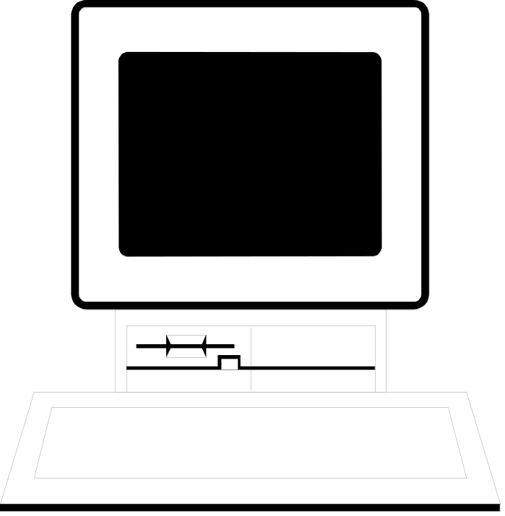
Shift from NOS to Intranet
Firewall
New LAN Functions:
-Applications
-Decision support
-Mainframe connectivity
-Exchange server
-Internet proxy
-firewall
-Systems management
-Development
-WINS & DHCP
E-Mail
DHCP
“95% of Fortune 1000 Will Have
Intranets By 2000” -- Forrester
Notes:
Five years ago, Aberdeen had a single Pentium-based server. Today we have six servers, including a symmetric multiprocessor. What’s happened to our LANS?
First, we added services for users such as internet access, e-mail, client-server applications, and database access.
But invisibly, the operating system services needed to support this workgroup grew by leaps and bounds:
- firewalls
- anti-virus software
- distributed backup
- WINS & DHCP, & domain management
- SNMP for desktop management
This means we needed more servers, and it radically complicated our IT planning, operations, and management.
Sound familiar?

Slide 13
Data Warehousing: “Great Idea, Hard to Implement”
OLTP Transactions
Transformation
Enterprise DW Server
Transformation
Data Mart Servers
Data Mining Tools
Data Visualization Tools
Decision Support Clients
Notes:
Anyone who has paid the personal price of implementing a data warehouse will nod their heads and agree that the benefits, which are real, come at a stiff cost in terms of IT resources.
First, they are hard to build.
Second, they are difficult and complicated to maintain.
The infrastructure needed for a well-running data warehouse is radically different than, say, a production online transaction processing system.

Slide 14
Client/Server Integration with
Web Applications
Ingres,
Jasmine
Oracle, Informix,
Sybase
DB2/MVS, IMS,
VSAM, IDMS
Just as IS masters client-server technology ...
Along comes the Web!
Issues:
  Legacy C-S integration
  Evolving but “Not There” standards
  N-tier complexities
  Programmer unfamiliarity
TCP/IP
LU 6.2
Web
Application
Server
Traditional
Client-
Server
IIOP
IIOP
HTTP
proprietary
net protocol
SQL
“Fat Client”
Web/Corba
Client
Notes:
20
So, your programmers finally got proficient at Powerbuilder, or Ingres Windows 4GL, or some other client-server tool.
You took a well-deserved trip to the Bahamas in 1997, came back and WHAM, your development roadmap suddenly said web, Java, and components.
This means the IT development organization suddenly has to deal with now-legacy C-S apps, and wrestle with fast evolving technologies like Java while developing that mission-critical app the CEO is demanding to stave-off your competitors.
Integrating new thin and thick web applications with existing data and applications will occupy at least a generation of programmers.

Slide 15
CEO’s Infinite Resource Planning Vision
Planning &
Forecasting
EDI
Enterprise
Systems
Commodity
Brokerage
Internet
THE WEB
Technologies
Notes:
And what’s the CEO’s goal ? Aberdeen believes it is found in this interconnected, cross-supply chain model, and that the movement toward and adoption of the IRP model is the next significant form of computing and of conducting business.
UPS/Fedex - Distribution Systems
NetLogistics - Best Way & Best Price
Cisco - 64% ($5.6 billion) of Cisco’s revenues now come over the web. CEO John Chambers believes that $1 - $2 trillion in business will be conducted on the web in 2002. His company saves $500 million a year by using the Internet.

Slide 16
Virtual Internet Computing:
Reality is Complex, Multi-Company
Company A
Company B
Manufacturer
Supplier
TCP/IP
Product
Transact
Consolidated
Financial Mgt
System
Catalog
Database
Data
TCP/IP
Distributed Web
Transact
ie
Transaction Engine
TCP/IP
Data
HTTP
Distributed Web
Internet desktop with Web Browser
Order Entry
Launch
Transaction Engine
System
Transact
TCP/IP
WWW Server
Launch
HTTP
N
WWW Server
Internet desktop with Web Browser
Company C
Trading Partner
Notes:
But to you who have to implement Internet supply chains, it’s a complex infrastructure at best. It starts with the hard wall between your company and your supplier’s. Security issues are rampant. Once those are solved, we get to data access and control, queries versus transactions, real time versus queued, etc.
The key to this puzzle is to throw out the notion that you can dictate to your suppliers exactly the IT infrastructure they can use. Here you need an architecture, the pragmatic use of standards, a secure boundary to your enterprise, and lastly a flexible infrastructure that can roll with the unforeseen punches we will undoubtedly get thrown in the next decade.

Slide 17
Building a Common Infrastructure:
Management Options
Do nothing
Outsource
Standards-based
Architecture
Vendor-based
Notes:
So, those were the six infrastructure fragmentation issues that will challenge you in the coming years.
What are we going to do about this infrastructure crisis?
Let’s evaluate five management approaches that you can implement.

Slide 18
Do Nothing
Take no active steps to build a manageable common IM and EM infrastructure
Benefits
  Just keep on doing what you’re doing
Implications
  Fragmentation gets worse
  Ability to disentangle and react diminishes
  If you buy this, today’s speakers have failed abjectly!
Notes:
Doing nothing is inertia. It’s hiding your head in the sand. It will delay but not solve any problems.

Slide 19
Outsource
Outside service provider handles IT services
Benefits
  Provider assumes future-shock risks
  Establishes cost-for-service basis
  One direction for finger pointing
Implications
  Will provider upgrade your technology base fast enough?
  What key IS skills will atrophy?
  Best suited for targeted cost-benefits (e.g., telecomm, “out-tasking”)
Notes:
We could do a whole hour on outsourcing issues …
Here, you sell your problems to somebody else. They take the technology risk, and you get on vendor to call on the carpet.
The risks are hidden in your contract. Will the outsourcer upgrade your technology base?
Will the programmer/analysts who know your business processes inside out now work for someone else?
Aberdeen’s take is that outsourcing makes sense for a growing list of specific situations.

Slide 20
Standards-based Infrastructure
Using industry standards, create an approved set of hardware, software, and networking technologies
Benefits
  Interoperability yields easier systems integration
  Less vendor technology lock-in
Implications
  Standards come slower; often are incomplete; always behind leading edge
  Do not always provide the optimal solution
  IS still has to build/integrate on standard platforms
Notes:
Many are drawn to standards, Why not? You get interoperability which gives your organization more choices and more competition. And let’s face it, standards-driven competition makes it harder for your IT suppliers to lock you in to their kit.
However,
- standards are usually late, incomplete, and slow
- they are seldom optimized for your particular environment and application needs
- And, you still are in the systems integration business.

Slide 21
Architecture
Choose the key technologies for an architecture, then the best-of-breed products to implement it
Benefits
  Architecture fits your enterprise’s requirements. No “one size fits all” solution
  Best-of-breed products can change over time while preserving the investment in the architecture
Implications
  Requires intense discipline to avoid “exceptions”
  What is best for the enterprise may not be best for the line-of-business system buyer
Notes:
An architectural approach has a lot going for it. Here, IT technologists choose the best technologies for your situation. Then, they can choose the best vendor solutions for the various pieces. A good architecture can absorb technology change at one level by isolating the changes from other levels. For example, changing your WAN protocols from SNA to TCP/IP.
Two caveats:
- It is always easy to defeat the long-term benefits of an architecture with exceptions. Example, an Oracle database shop needs an application package that only runs on Sybase.
-

Slide 22
Vendor-based
Choose a vendor’s solutions and build on those
Benefits
  Vendor endures the technology shocks
  Focused on rolling out leading-edge solutions
  Some supply value-added technology integration
Implications
  No single vendor can supply all the infrastructure
  If the vendor fails, so do you
  At the mercy of the vendor’s technology curve
  Nevertheless, an attractive choice
Notes:
A vendor-based infrastructure puts the technology hand-grenade in your supplier’s hands. The vendor worries about the technology integration, changes, and gaining their own competitive advantage through their products.
Implications
- Much as we would like, no single vendor can supply it all. Sorry, Microsoft.
- You are in effect outsourcing your common infrastructure integration. There are risks.
- On the whole, many IT organizations are attracted to vendor-based infrastructures simply because there is a lot of value for the money.

Slide 23
Aberdeen’s Rating of
Management Options
Do nothing
Outsource
Standards-based
Architecture
Vendor-based
Bad idea
Parts, yes. The whole, never. Staff, never.
Remember DCE, DME & OSI?
Good idea. Works best with strong central IS.
Good idea. Requires excellent relationship and basis for trust.

Slide 24
Aberdeen Conclusions
IT-driven business is the wave of the present
Information technology is exploding -- threatening to fragment IS development, operations, and networks into unmanageable pieces
An architected, vendor-backed common infrastructure yields the greatest benefits
  Must support both information and enterprise management needs
Notes:
Discuss bullets.
Aberdeen sees four suppliers with the ability to significantly impact the market for infrastructure:
IBM-- will deliver business-object components from the San Francicso project on top of a robust infrastructure that includes DB2, CICS, MQ, and e-business infrastructure. IBM’s ace in the hole is the Global Services organization that can glue the infrastructure onto custom applications.
Microsoft -- Has been pushing infrastructure for a year under the “digital nervous system” name. Poor-to-fair on heterogeneous infrastructure; non-existent in services, Microsoft nonetheless keeps expanding its infrastructure software which is highly credible for what it can do.
Oracle -- has a database-centric vision of infrastructure. Applications and services complement an enterprise-capable server infrastructure platform.
Computer Associates -- is building bridges between its Unicenter TNG enterprise management products, application development, and data management products such as Jasmine and Ingres. CA has a leg up in heterogeneous environments. And give CA good marks for vision, but services need to be beefed up.

